Slide 1
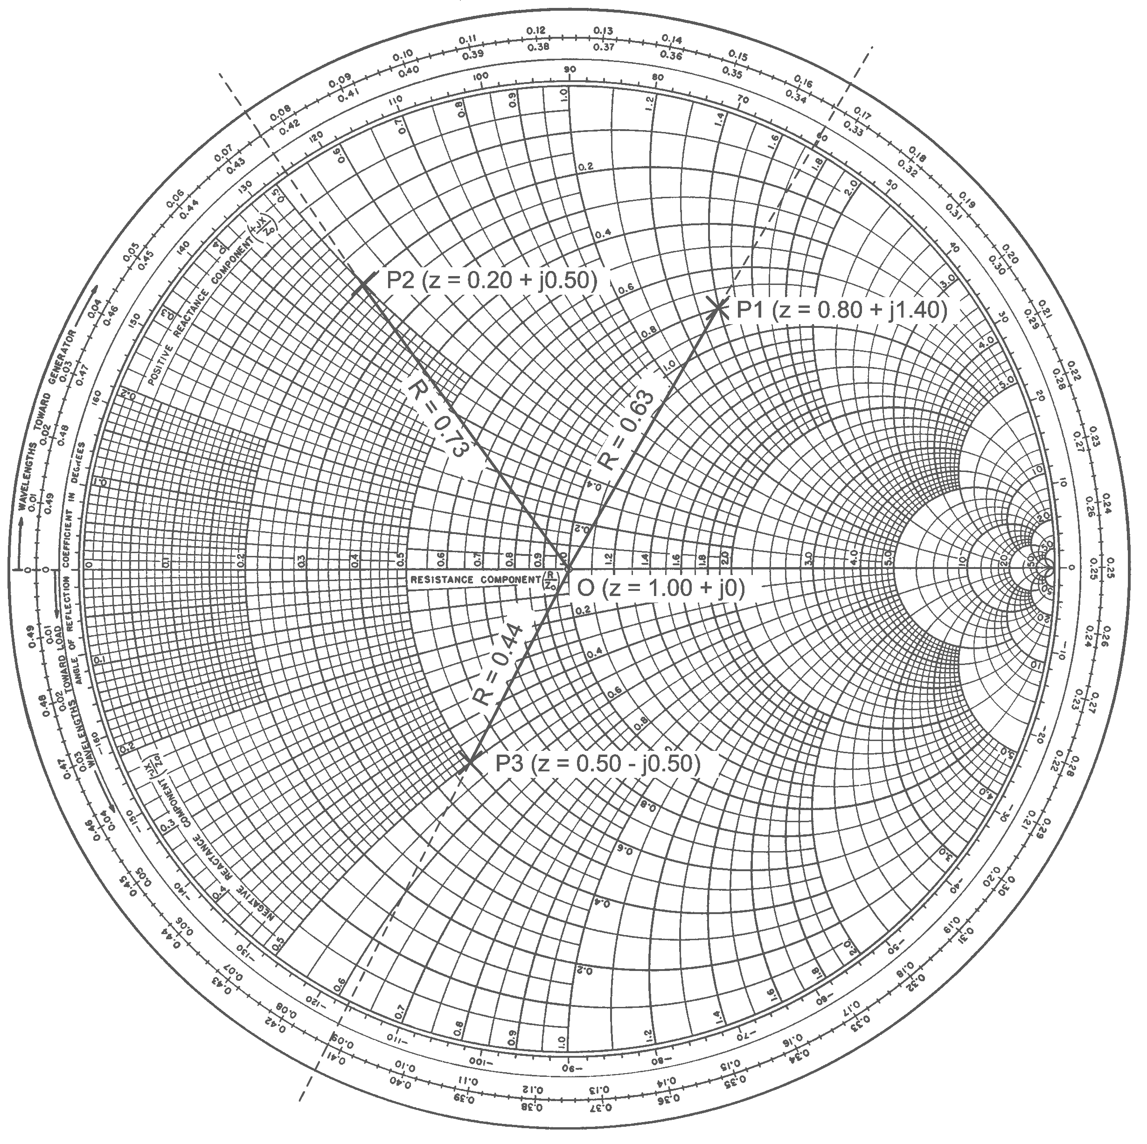


Advanced high efficiency power amplifier architectures
Cardiff University – Centre for high frequency engineering
David Collins – 2E0LXD

Slide 2
Contents
Amplifier Theory
Efficiency
Linearity
Spectral Vs Power Efficiency
Conventional High Efficiency Modes
Waveform Engineered Modes
Advanced PA Architectures
treasurer@cardiffars.org.uk

Slide 3
The Power Amplifier
Amplifies an RF signal to the power level required for transmission over a distance.
Achieved by converting DC power to RF power.
The power amplifier is the largest consumer of energy in a radio system
Impacts on overall system performance.
treasurer@cardiffars.org.uk

Slide 4
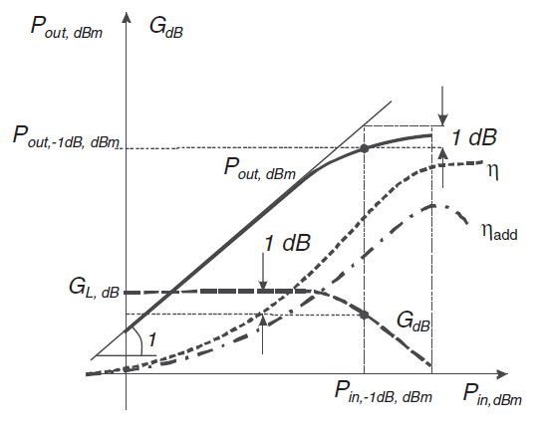
Power Amplifier Design
Linearity
Efficiency
Gain
Power
A classical engineering problem where design parameters are traded to meet the desired specification.
treasurer@cardiffars.org.uk

Slide 5
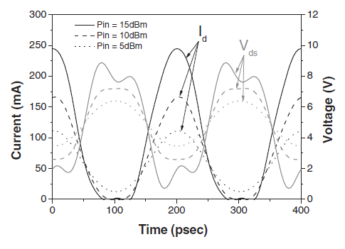



PA Efficiency
Linearity
Efficiency
Gain
Power
Typical class AB waveform
$η=\frac{P_{out}}{P_{DC}}$
PAE $=\frac{P_{out}−P_{in}}{P_{DC}}$
$P_{diss}=P_{DC}−P_{out}+P_{in}$
Power is dissipated in the transistor where the out of phase voltage and current waveforms overlap.
treasurer@cardiffars.org.uk

Slide 6
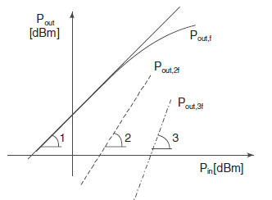



PA Linearity
Linearity
Efficiency
Gain
Power
Gain compression
$v_{out}=a_{1}v_{in}+a_{2}v_{in}^{2}+a_{3}v_{in}^{3}…$
substituting
$v_{in}=vcos(ωt)$
$v_{out}=a_{1}vcos(ωt)+\frac{a_{2}v^{2}}{2}(1+cos\left(ωt\right))+\frac{a_{3}v^{3}}{4}(3\cos\left(ωt\right)+cos⁡(3ωt))$
$v_{fund}=a_{1}vcos(ωt)±\frac{3}{4}a_{3}v^{3}cos\left(ωt\right)$
treasurer@cardiffars.org.uk

Slide 7
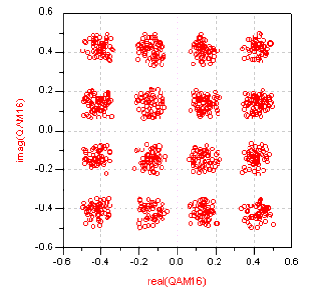
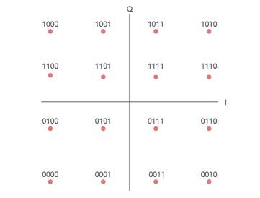

Spectral Vs Power Efficiency
Signal $=Acos(ωt±∅)$
Amplitude
Frequency
Phase
C4FM
DMR
D-STAR
QAM
signal distortion
treasurer@cardiffars.org.uk

Slide 8
Reduced conduction angle
Class A
Class AB
As conduction angle reduces, the power dissipated in the device decreases.
Produces harmonics which require resonating out.
Trade off power for efficiency.
Class C operation is hard to realise in solid state devices.
treasurer@cardiffars.org.uk

Slide 9
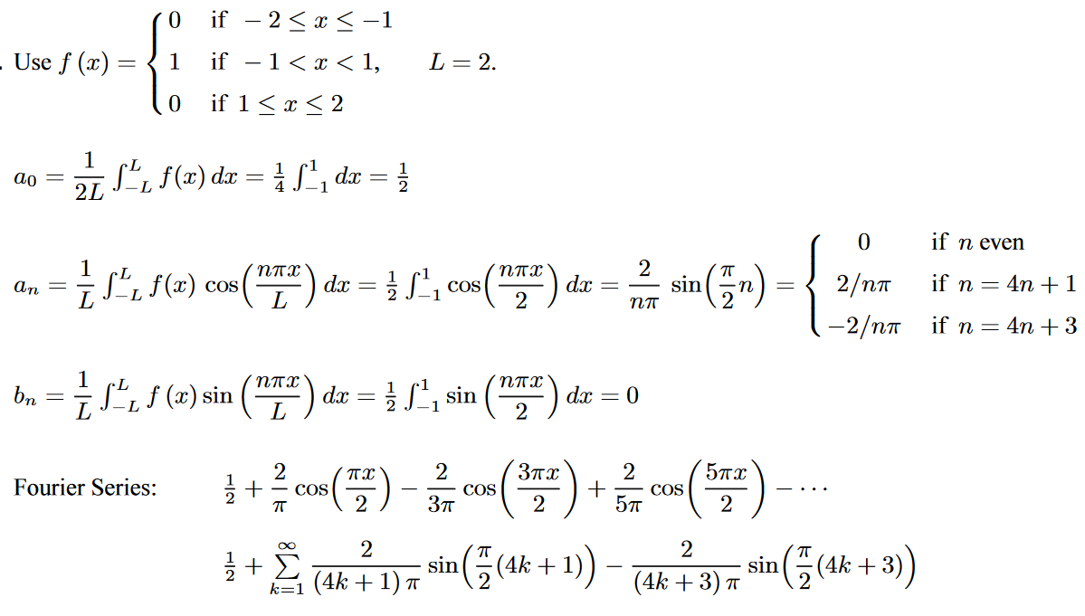
Waveform Engineering
Another Time!
treasurer@cardiffars.org.uk

Slide 10
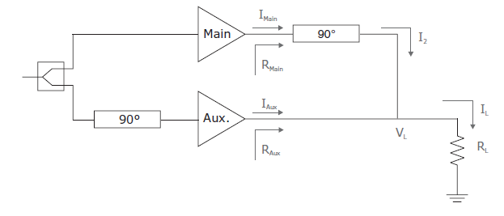
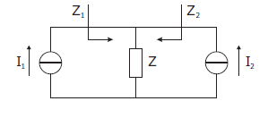
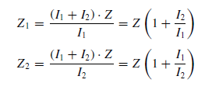
Efficiency Enhanced Architectures
Doherty PA (DPA)
The RF load is modified by applying current from a second, phase coherent source.
Main Device biased in class AB
Aux Device biased in class C
Impedance seen by the main device goes down as the auxiliary current increases.
treasurer@cardiffars.org.uk

Slide 11
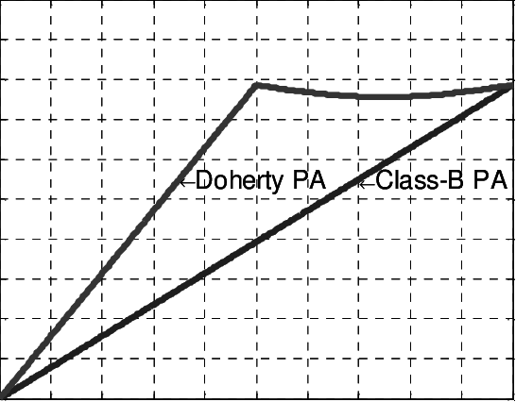
Efficiency Enhanced Architectures
Doherty PA (DPA)
treasurer@cardiffars.org.uk

Slide 12
References
High Efficiency RF and Microwave Solid State Power Amplifiers
Paolo Colantonio, Franco Giannini, and Ernesto Limiti
RF power amplifiers for RF communication
Steve C. Cripps
treasurer@cardiffars.org.uk

